Slide 1
Timer Peripherals

Slide 2
KL25 Timer Peripherals
PIT - Periodic Interrupt Timer
Can generate periodically generate interrupts or trigger DMA (direct memory access) transfers
TPM - Timer/PWM Module
Connected to I/O pins, has input capture and output compare support
Can generate PWM signals
Can generate interrupts and DMA requests
LPTMR - Low-Power Timer
Can operate as timer or counter in all power modes (including low-leakage modes)
Can wake up system with interrupt
Can trigger hardware
Real-Time Clock
Powered by external 32.768 kHz crystal
Tracks elapsed time (seconds) in 32-bit register
Can set alarm
Can generate 1Hz output signal and/or interrupt
Can wake up system with interrupt
SYSTICK
Part of CPU core’s peripherals
Can generate periodic interrupt

Slide 3
Timer/Counter Peripheral Introduction
Events
Reload Value
Reload
or
Presettable Binary Counter
÷2 or RS
PWM
Clock
Interrupt
Current Count
Common peripheral for microcontrollers
Based on presettable binary counter, enhanced with configurability
Two basic modes
Counter mode: count pulses which indicate events (e.g. odometer pulses)
Timer mode: clock source is periodic, so counter value is proportional to elapsed time (e.g. stopwatch)
Main configurable options
Current count value
Count reload value
Count direction: up or down
Counter’s clock source
Counter’s overflow/underflow action
Generate interrupt
Reload counter, resume counting
Toggle hardware output signal
Stop!

Slide 4
Periodic Interrupt Timer

Slide 5
Periodic Interrupt Timer
Read/write timer start value (TSV) from PIT_LDVALn
Generates periodic interrupts using a 32-bit counter
Load start value (32-bit) from LDVAL
Counter decrements with each clock pulse
Fixed clock source for PIT - Bus Clock from Multipurpose Clock Generator - e.g. 24 MHz
When timer value (CVAL) reaches zero
Generates interrupt
Reloads timer with start value
Start Value
Reload
Clock
Presettable Binary Counter
Interrupt
Read current timer value (TVL) from PIT_CVALn

Slide 6
Periodic Interrupt Timer
PIT Interrupt
Write 1000 to TSV
Enabling timer loads counter with 1000, starts counting
TVL counts down to 0
PIT interrupt generated, counter reloads with 1000, starts counting
PIT interrupt generated, counter reloads with 400, starts counting
PIT interrupt generated, counter reloads with 400, starts counting
PIT interrupt generated, counter reloads with 400, starts counting
Write 700 to TSV

Slide 7
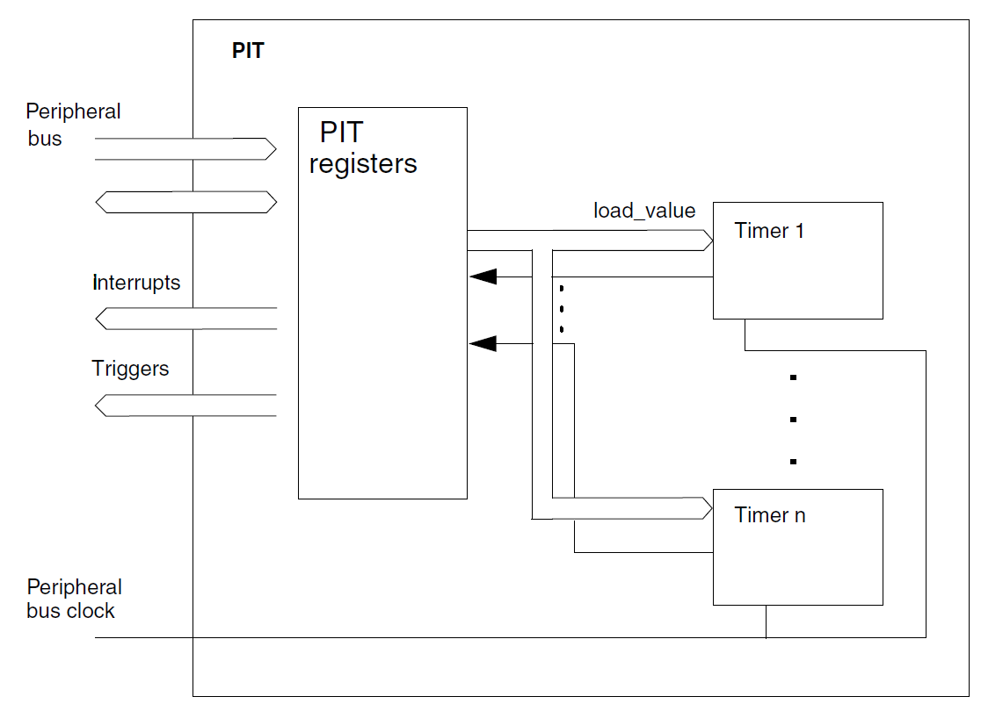
PIT Configuration
1: Enable clock gating!
SIMCGC6 PIT
2: Module Control Register (PIT->MCR)
MDIS - Module disable
0: module enabled
1: module disabled (clock disabled)
FRZ - Freeze - stops timers in debug mode
0: timers run in debug mode
1: timers are frozen (don’t run) in debug mode
Multiple channels within a PIT
KL25Z has two channels
Can chain timers together to create 64-bit timer

Slide 8
Control of Each Timer Channel n
CMSIS Interface:
General PIT settings accessed as struct: PIT->MCR, etc.
Channels are accessed as an array of structs: PIT->CHANNEL[n].LDVAL, etc
PIT_LDVALn: Load value (PIT->CHANNEL[n].LDVAL)
PIT_CVALn: Current value (PIT->CHANNEL[n].CVAL)
PIT_TCTRLn: Timer control (PIT->CHANNEL[n].TCTRL)
CHN: Chain
0: independent timer operation, uses own clock source
1: timer n is clocked by underflow of timer n-1
TIE: Timer interrupt enable
0: Timer will not generate interrupts
1: Interrupt will be requested on underflow (i.e. when TIF is set)
TEN: Timer enable
0: Timer will not count
1: Timer is enabled, will count
PIT_TFLGn: Timer flags
TIF: Timer interrupt flag
1: Timeout has occurred

Slide 9
Configuring the PIT
Enable clock to PIT module
SIM->SCGC6 |= SIM_SCGC6_PIT_MASK;
Enable module, freeze timers in debug mode
PIT->MCR &= ~PIT_MCR_MDIS_MASK;
PIT->MCR |= PIT_MCR_FRZ_MASK;
Initialize PIT0 to count down from starting_value
PIT->CHANNEL[0].LDVAL = PIT_LDVAL_TSV(starting_value);
No chaining of timers
PIT->CHANNEL[0].TCTRL &= ~PIT_TCTRL_CHN_MASK;

Slide 10
Calculating Load Value
Goal: generate an interrupt every T seconds
LDV = round(T*f_{count} - 1)
-1 since the counter counts down to 0
Round since LDV register is an integer, not a real number
Rounding provides closest integer to desired value, resulting in minimum timing error
Example: Interrupt every 137.41 ms
LDV = 137.41 ms * 24 MHz - 1 = 3297839
Example: Interrupt with a frequency of 91 Hz
LDV = (1/91 Hz)*24 MHz - 1 = round (263735.2637-1) = 263734

Slide 11
Configuring the PIT and NVIC for Interrupts
Configure PIT
Let the PIT channel generate interrupt requests
PIT->CHANNEL[0].TCTRL |= PIT_TCTRL_TIE_MASK;
Configure NVIC
Set PIT IRQ priority
NVIC_SetPriority(PIT_IRQn, 128); // 0, 64, 128 or 192
Clear any pending IRQ from PIT
NVIC_ClearPendingIRQ(PIT_IRQn);
Enable the PIT interrupt in the NVIC
NVIC_EnableIRQ(PIT_IRQn);
Make sure interrupts are not masked globally
__enable_irq();

Slide 12
Interrupt Handler
One interrupt for entire PIT
CMSIS ISR name: PIT_IRQHandler
ISR activities
Determine which channel triggered interrupt
if (PIT->CHANNEL[n].TFLG & PIT_TFLG_TIF_MASK) {
Clear interrupt request flag for channel by writing one to it
PIT->CHANNEL[0].TFLG |= PIT_TFLG_TIF_MASK;
Do the ISR’s work

Slide 13
Starting and Stopping the Timer Channel
Start the timer channel
PIT->CHANNEL[0].TCTRL |= PIT_TCTRL_TEN_MASK;
Stop the timer channel
PIT->CHANNEL[0].TCTRL &= ~PIT_TCTRL_TEN_MASK;

Slide 14
Example: Stopwatch
Measure time with 100 us resolution
Display elapsed time, updating screen every 10 ms
Controls
S1: toggle start/stop
Use PIT
Counter increment every 100 us
Set to PIT Channel 0 to expire every 100 us
Calculate load value LDVAL = round (100 us * 24 MHz -1) = 2399
LCD Update every 10 ms
Update LCD every nth PIT ISR
n = 10 ms/100us = 100
Don’t update LCD in ISR! Too slow.
Instead set flag LCD_Update in ISR, poll it in main loop

Slide 15
Timer/PWM Module (TPM)

Slide 16
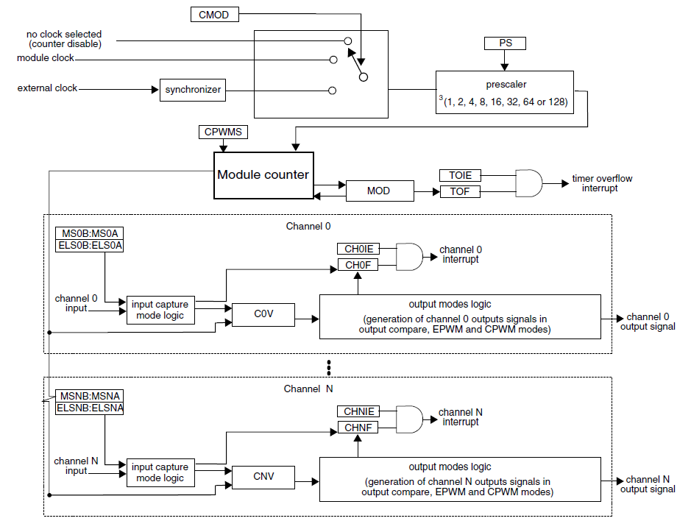
TPM - Timer/PWM Module
Core: Module counter
Two clock options - external or internal
Prescaler to divide clock by 1 to 128
16-bit counter
Can count up or up/down
Can reload with set load value or wrap around (to FFFF or 0000)
Multiple (6) independent channels
3 modes
Capture Mode: capture timer’s value when input signal changes
Output Compare: Change output signal when timer reaches certain value
PWM: Generate pulse-width-modulated signal. Width of pulse is proportional to specified value.
Each channel can generate interrupt, DMA request, hardware trigger on overflow
One I/O pin per channel: TPM_CHn

Slide 17
Timer Configuration
Clock source
CMOD: selects internal or external clock
Prescaler
PS: divide selected clock by 1, 2, 4, 8, 16, 32,64, 128
Count Mode: direction
CPWMS: count up (0) or up & down (1)
Count Modulus: value to counts up to
MOD: 16-bit
Timer overflows when counter goes past MOD value
Up counting: 0, 1, 2, … MOD, 0/Overflow, 1, 2, … MOD
Up/down counting: 0, 1, 2, … MOD, MOD-1/Interrupt, MOD-2, … 2, 1, 0, 1, 2, …
DMA: Enable DMA transfer on overflow
TOF: Flag indicating timer has overflowed

Slide 18
Basic Counter Mode
Count external events applied on input pin
Set CMOD = 01 to select external clock
Set PS = 000 (unless division needed
Timer overflow flag TOF set to 1 upon receiving MOD * prescaler pulses
Can generate interrupt if TOIE is set
2-0 PS | Prescaler Factor
000 | 1
001 | 2
010 | 4
011 | 8
100 | 16
101 | 32
110 | 64
111 | 128

Slide 19
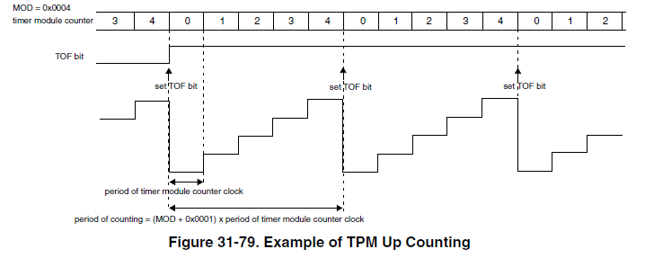
Count Mode and Modulo - Counting Up
Counter increments with each clock tick
When counter reaches MOD,
set TOF bit (timer overflow)
reset counter value to 0
Frequency of overflows is timer clock frequency / (1 + MOD)

Slide 20
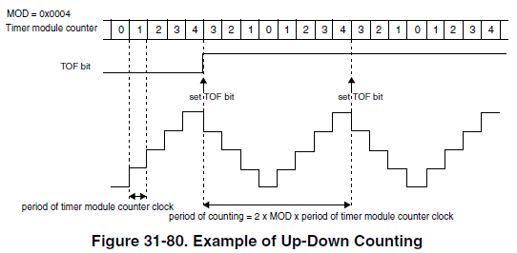
Count Mode and Modulo - Counting Up and Down
Up-counting phase
Counter increments with each clock tick
When counter reaches MOD, set TOF bit (timer overflow), set to down-count mode
Down-counting phase
Counter decrements with each clock tick
When counter reaches 0, set to up-count mode
Frequency of overflows is timer clock frequency / (2 * MOD)

Slide 21
TPM Configuration (TPMx_CONF)
TRGSEL - input trigger select
CROT - counter reload on trigger
CSOO - counter stop on overflow
CSOT - counter start on trigger
GTBEEN - external global time base enable (rather than LPTPM counter)
DBGMODE - let LPTPM counter increment during debug mode
DOZEEN - pause LPTPM when in doze mode

Slide 22
TPM Status (TPMx_STATUS)
TOF - Counter has overflowed
CHxF - Channel event has occurred (event depends on mode)

Slide 23
Major Channel Modes
Input Capture Mode
Capture timer’s value when input signal changes
Rising edge, falling edge, both
How long after I started the timer did the input change?
Measure time delay
Output Compare Mode
Modify output signal when timer reaches specified value
Set, clear, pulse, toggle (invert)
Make a pulse of specified width
Make a pulse after specified delay
Pulse Width Modulation
Make a series of pulses of specified width and frequency

Slide 24
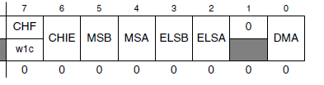
Channel Configuration and Value
Configuration: TPMx_CnSC
CHF - set when event occurs
CHIE - enable channel to generate an interrupt
MSB:MSA - mode select
ELSB:ELSA - edge or level select
DMA - enable DMA transfers
Value: TPMx_CnV
16-bit value for output compare or input capture

Slide 25
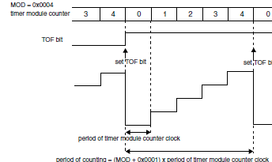
Input Capture Mode
Select mode with CPWMS = 0, MSnB:MSnA = 00
TPM_CHn I/O pin operates as edge- sensitive input
ELSnB:ELSnA select rising (01) or falling edge (10) or both (11)
When valid edge is detected on TPM_CHn…
Current value of counter is stored in CnV
Interrupt is enabled (if CHnIE = 1)
CHnF flag is set (after 3 clock delay)
TPM_CHn
CnV
initialized value
3

Slide 26
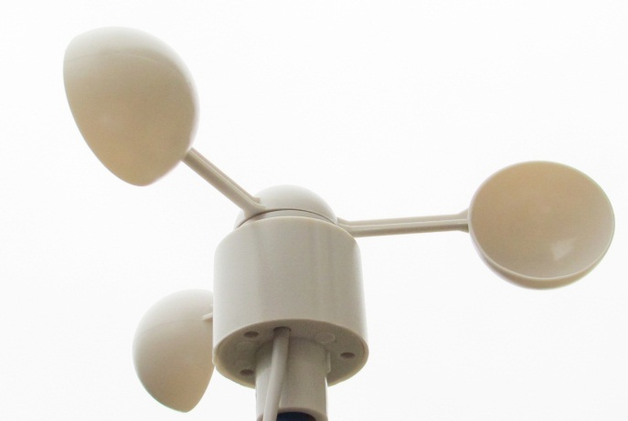
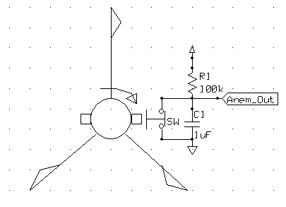
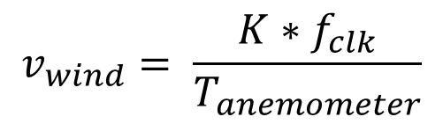
Wind Speed Indicator (Anemometer)
Rotational speed (and pulse frequency) is proportional to wind velocity
Two measurement options:
Frequency (best for high speeds)
Width (best for low speeds)
Can solve for wind velocity v
How can we use the TPM for this?
Use Input Capture Mode to measure period of input signal
$$v_{wind}= \frac{K∗f_{clk}}{T_{anemometer}}$$

Slide 27
TPM Capture Mode for Anemometer
Configuration
Set up TPM to count at given speed from internal clock
Set up TPM channel for input capture on rising edge
Operation: Repeat
First TPM interrupt - on rising edge
Reconfigure channel for input capture on falling edge
Clear TPM counter, start it counting
Second TPM interrupt - on falling edge
Read capture value from CnV, save for later use in wind speed calculation
Reconfigure channel for input capture on rising edge
Clear TPM counter, start it counting

Slide 28
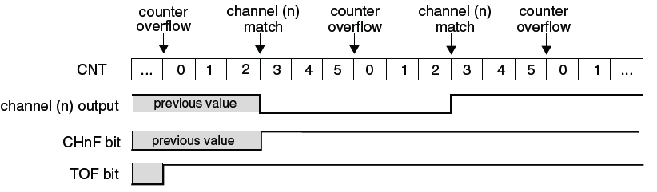
Output Compare Mode
Events
MSnB | ELSnB | ELSnA | Output Action
0 | 0 | 1 | Toggle
0 | 0 | 0 | Clear
0 | 1 | 1 | Set
1 | 1 | 0 | Pulse low
1 | x | 1 | Pulse high
CNT | 3 | 0 | 1 | 2 | 3 | 4 |  | 0 | 1 | 2 | 3
CnV | 2 | 2 | 2 | 2 | 2 | 2 |  | 2 | 2 | 2 | 2
TPM_CHn
CHnF | 0 | 0 | 0 | 1 | 1 | 1 |  | 1 | 1 | 1 | 1
Select mode with CPWMS = 0, MSnA = 1
TPM_CHn I/O pin operates as output
When CNT matches CnV …
Output signal TPM_CHn is updated
CHnF flag is set
CHnI Interrupt is enabled (if CHnIE = 1)
Can select one of multiple output signal actions on match
Toggle, clear, set, pulse low, pulse high

Slide 29
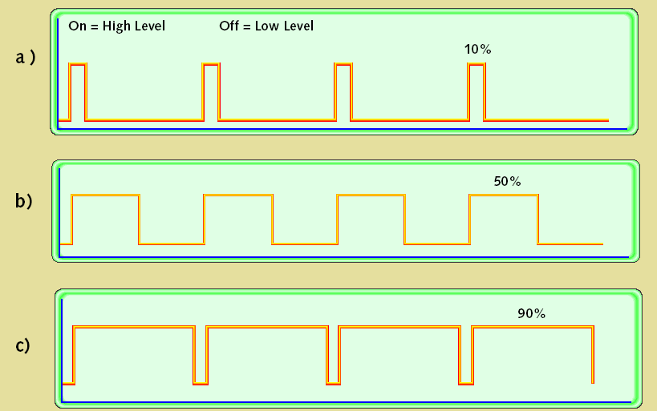
Pulse-Width Modulation
Allows a single digital signal to send more than two values (0, 1)
Simple encoding: value is the fraction of time signal is a 1
Signal can easily be averaged to create an analog voltage
PWM signal characteristics
Modulation frequency – how many pulses occur per second (fixed)
Period – 1/(modulation frequency)
On-time – amount of time that each pulse is on (asserted)
Duty-cycle – on-time/period
Adjust on-time (hence duty cycle) to represent the analog value

Slide 30
Uses of Pulse-Width Modulation
Digital communication is less sensitive to noise than analog methods
PWM provides a digital encoding of an analog value
Much less vulnerable to noise
Digital power amplifiers are more efficient and less expensive than analog power amplifiers
Applications: motor speed control, light dimmer, switch-mode power conversion
Load (motor, light, etc.) responds slowly, averages PWM signal

Slide 31
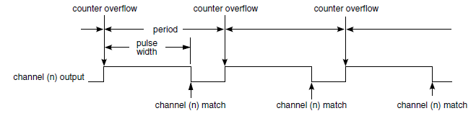
Edge-Aligned PWM Mode
Edge-aligned - leading edges of signals from all PWM channels are aligned
Uses count up mode
Period = (MOD + 1) cycles
Pulse width = (CnV) cycles
MSnB:MSnA = 01, CPWMS = 0
ELSnB:ELSnA = 10 - high-true pulses
ELSnB:ELSnA = x1 - low-true pulses

Slide 32
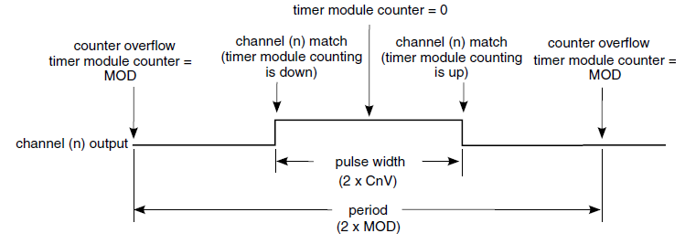
Center-Aligned PWM Mode
Center-aligned - centers of signals from all PWM channels are aligned
Uses count up/down mode
Period = 2*MOD cycles. 0x0001 <= MOD <= 0x7FFFF
Pulse width = 2*CnV cycles
MSnB:MSnA = 10, CPWMS = 1
ELSnB:ELSnA = 10 - high-true pulses
ELSnB:ELSnA = x1 - low-true pulses

Slide 33
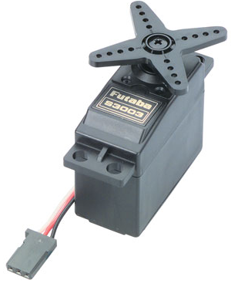
Servo Motor
Arms/Crown
Pos. Sensor
Actual Position
Gearbox
Motor
Commanded Position
Controller
Components
Motor
Gearbox
Output shaft with crown and position sensor
Control system
Inputs
Power & Ground
PWM control signal
Control system
Moves motor to commanded position
Uses position sensor for feedback
Gearing from motor to output shaft
Increases torque, reduces speed
Limited range of rotation (e.g. 90⁰), can’t do full rotation

Slide 34
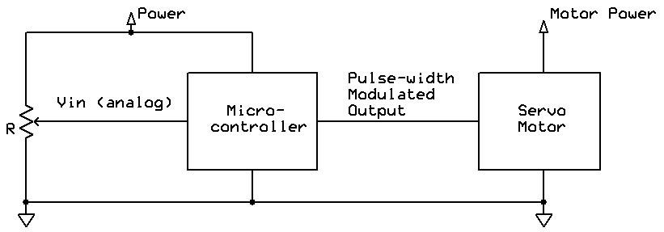
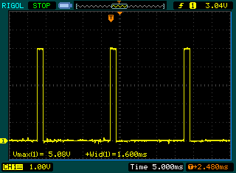
Using PWM to Drive a Servo Motor
PWM signal tells servo desired shaft angle
20 ms period (50 Hz frequency)
1 to 2 ms pulse width
Position proportional to pulse width
1.5 ms: centered (neutral)
<1.5 ms: counter-clockwise
>1.5 ms: clockwise

Slide 35
Low Power Timer (LPTMR)

Slide 36
LPTMR Overview
Prescaler/ Glitch Filter
16-bit Counter CNR
Comparator
LPTMR Interrupt and Hardware Trigger
16 bit up-counter which operates in all power modes (stop, wait, etc.)
Can count time or external pulses
Glitch filter removes high-frequency noise from pulses
Can generate interrupt when counter matches compare value
Interrupt wakes MCU from any low power mode
Registers
Counter register LPTMRx_CNR
Compare register LPTRMx_CMR
Prescale register LPTMRx_PSR
Control Status register LPTMRx_CSR
Compare Value CMR

Slide 37
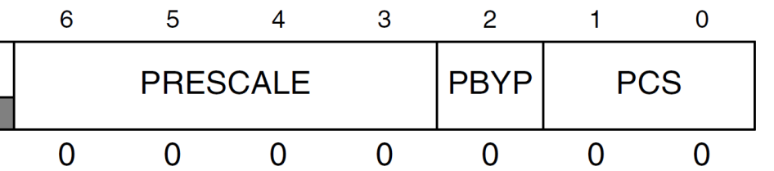
Prescale Register
PRESCALE: divide by 2 to 65536
Time counter mode: Divide input clock by 2^{PRESCALE+1}
Pulse counter mode: Is glitch filter which recognizes input signal change after 2^{PRESCALE} rising clock cycles
PBYP: Prescaler Bypass
0: use prescaler
1: bypass prescaler
PCS: Prescaler Count Select
Inputs available depend on chip configuration, see KL25 SRM Chapter 3: Chip Configuration
PCS | Clock Source
00 | MCGIRCLK — internal reference clock (not available in LLS and VLLS modes)
01 | LPO — 1 kHz clock (not available in VLLS0 mode)
10 | ERCLK32K (not available in VLLS0 mode when using 32 kHz oscillator)
11 | OSCERCLK — external reference clock (not available in VLLS0 mode)

Slide 38
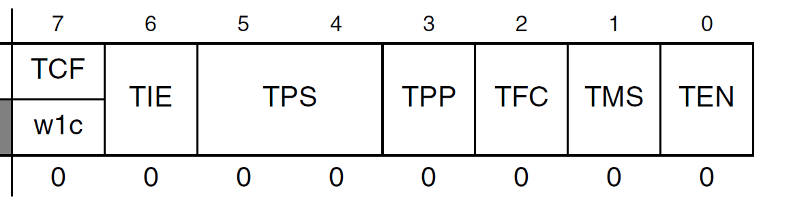
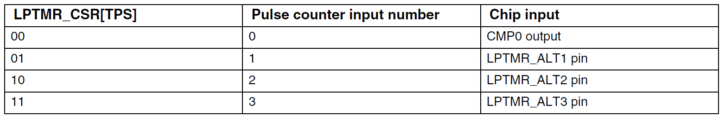
Control Status Register
TCF: Timer Compare Flag
1 if CNR matches CMR and increments
TIE: Timer Interrupt Enable
Set to 1 to enable interrupt when TCF == 1
TPS: Timer Pin Select for pulse counter mode
Inputs available depend on chip configuration, see KL25 SRM Chapter 3: Chip Configuration

Slide 39
Control Status Register
TPP: Timer Pin Polarity
0: input is active high, increments CNR on rising edge
1: input is active low, increments CNR on falling edge
TFC: Timer Free-running Counter
0: Reset CNR whenever TCF is set (on match)
1: Reset CNR on overflow (wrap around)
TMS: Timer Mode Select
0: Time counter
1: Pulse counter
TEN: Timer Enable
1: Enable LPTMR operation

Slide 40
Watchdog Timer

Slide 41
Watch Dog Timer (WDT) Concepts
WDT overflows, resets system
Start WDT
Service WDT
Overflow
WDT Value
Time
Program State
OK
Hit a bug and hung
Reset ISR
OK
Goal: detect if program is not refreshing WDT correctly (≈ malfunctioning?)
Mechanism:
Program periodically tells WDT that it is OK (services the WDT)
If timer ever overflows (times out), then program didn’t say it was OK soon enough, so reset the MCU
Typically used as a “last resort” mechanism for forcing system software back into known state

Slide 42
Windowed Watch Dog Timer Concepts
Service WDT in window
Service WDT
before window,
causing reset
Start WDT
Overflow
Window
WDT Value
Time
Window State
Closed
Open
Closed
Open
Program State
OK
Hit bug
Reset ISR
Can only service WDT when WDT counter value is in a certain range
Any service attempt outside the window will cause the WDT to reset the system
Windowed WDT improves reliability
Almost eliminates likelihood of program crash which still services the WDT

Slide 43
Kinetis KL25Z WDT (COP)
WDT is called COP (Computer Operating Properly) by Freescale
Details in KL25 Subfamily Reference Manual, Chapter 3 (Chip Configuration)
Registers
COPCTRL: COP Control Register (COPC in CMSIS)
SRVCOP: Service COP register
Initializing the COP
Write to COPCTRL
Write-protected: Only first write to COPCTRL after a reset is recognized, subsequent writes are ignored
Can disable COP by clearing COPCTRL[COPT]

Slide 44
COP Configuration
Control Bits (COPCTRL) |  | Clock Source | COP Window Opens | COP Overflow Count
COPCLKS | COPT
n/a | 00 | n/a | n/a | COP is disabled
0 | 01 | 1 kHz | n/a | 2⁵ cycles, 32 ms
0 | 10 | 1 kHz | n/a | 2⁸ cycles, 256 ms
0 | 11 | 1 kHz | n/a | 2¹⁰ cycles, 1024 ms
1 | 01 | Bus | 6144 cycles | 2¹³ cycles
1 | 10 | Bus | 49152 cycles | 2¹⁶ cycles
1 | 11 | Bus | 196608 cycles | 2¹⁸ cycles
Default setting
Select clock source with COPCTRL[COPCLKS]
1 kHz or bus clock (e.g. 24 MHz)
Set time-out divider with COPCTRL[COPT]
Optional Windowed operation (when using bus clock) by setting COPCTRL[COPW]
Program must reset COP within last 25% of time-out period

Slide 45
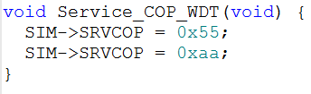
WDT Service and Operation
Servicing (resetting) the COP
Reset COP timer by writing 0x55 and then 0xAA to SRVCOP during timeout period
Writing wrong value causes COP to reset MCU immediately
Reset actions
MCU is reset
WDOG bit in Reset Control Module (RCM) System Reset Status Register 0 (SRS0) is set to show watchdog caused reset

Slide 46
Determining Cause of Reset
Reset Control Module (RCM) System Reset Status Register 0 (SRS0) bits
POR: power-on reset
PIN: external reset pin asserted
WDOG: COP watchdog timer timed out
LOL: Loss of lock in PLL (clock generation)
LOC: Loss of clock detected by MCG clock monitor
LVD: Low voltage detected
WAKEUP: System was asleep in low-leakage mode when a LLWU source was activated

Slide 47

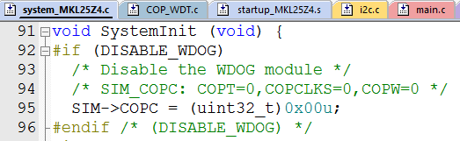
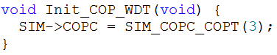
SystemInit()
SystemInit() function in system_MKL25Z4.c disables the COP WDT by default because DISABLE_WDOG is non-zero
All subsequent writes to SIM->COPC are ignored by MCU
Including our own initialization code!
To fix this, redefine DISABLE_WDOG to 0, so the compiler ignores lines 93-95 of the source code

Slide 48
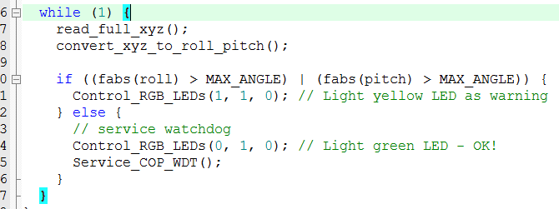
Demonstration Code – WDT Demo
System flashes red LED on startup
Loop:
Read accelerometer
Calculate board inclination
Is board flat (within 20⁰ of horizontal)?
Yes: Light green LED and service the watchdog
No: Light yellow LED and do NOT service the watchdog
Holding the board tilted for more than about 1 second will cause the WDT to trigger, resetting the CPU (shown by flashing red LED)

Slide 49
WDT Best Practices
Don’t scatter WDT service commands throughout your code
There should just be one or a few such commands in the entire program
Choose WDT period appropriately
Too long: System is out of control long enough to get into real trouble
Too short: You will need to reset WDT frequently in your code, complicating development with code writing and timing analysis overhead
Frequent WDT resets? (Boot loop)
Consider logging abnormal causes of reset for later diagnosis
Determine how production code should respond to WDT resets (rare vs. frequent)
WDT should be difficult to accidentally disable in software

Slide 50
Using a WDT in a Multithreaded Application
Each periodic task updates a timestamp when it starts running
Checker thread
Checks timestamp for each thread i to verify it ran recently (enough).
If all threads are ok, restart the WDT.
If not, allow WDT to expire.
Does this detect every possible problem?
No, but it catches many and is far better than not using a WDT
How to deal with non-periodic tasks?
Application-dependent!
The checker could be integrated into the scheduler – possible programming project

Slide 51
Debugging with the WDT
How do you debug a system with a WDT?
Don’t want MCU to reset as soon as the code hits a breakpoint!
Need to disable WDT somehow if it isn’t done automatically
KL25 COP behavior – handles WDT automatically
If using bus clock
COP doesn’t increment if MCU is in debug mode or stop mode (including VLPS and LLS)
COP resumes counting upon exiting these modes
If using 1 kHz clock
COP cleared to zero as long as MCU is in debug or stop mode (including VLPS and LLS)
COP resumes counting (from zero) upon exiting these modes
Disabled when in VLLSx mode

